Slide 1

To the Moon and to Integration
Parallels of the Space Race & the Civil Rights Movement

Slide 2
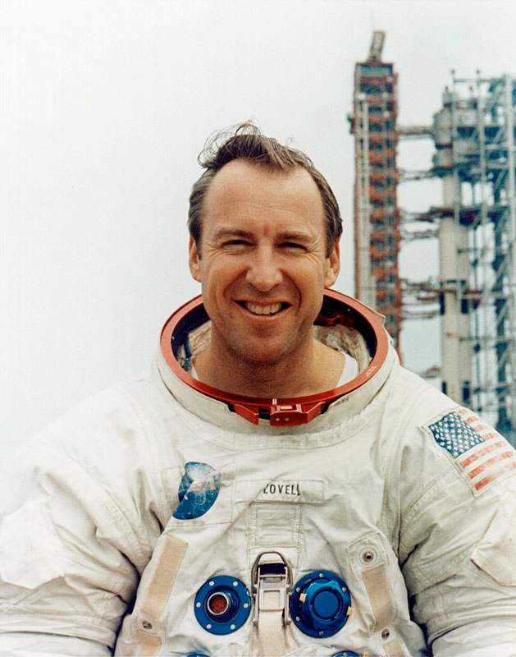
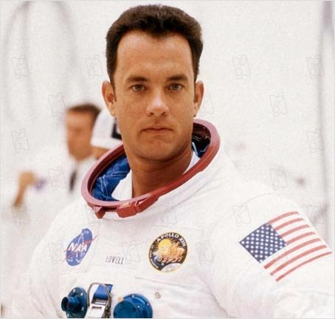
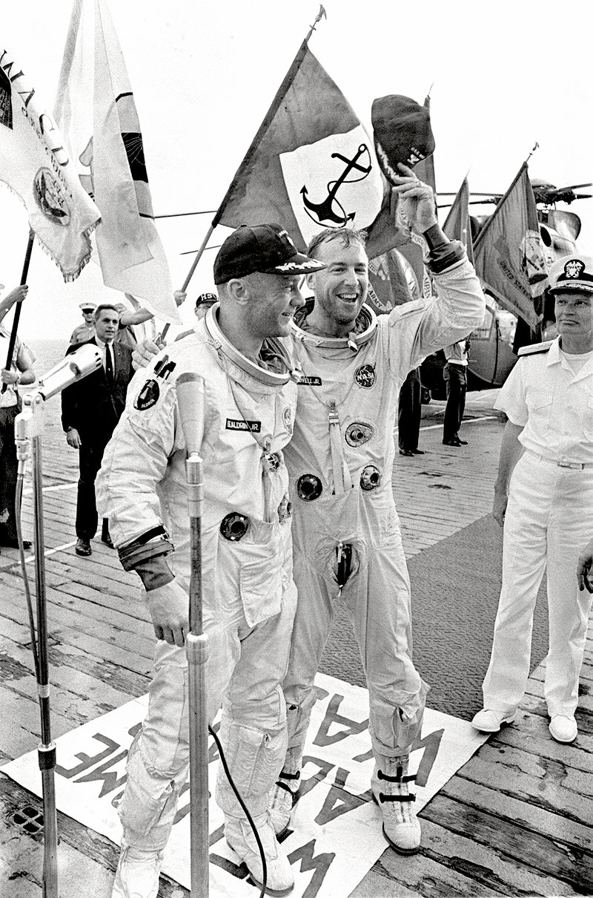
Will the real Jim Lovell please stand up?

Slide 3
Activate your Background knowledge
      Many of the people I meet -- especially people of color -- think the space program is the exclusive domain of white, middle-aged men with crew cuts. But the reality is that African-Americans have played an active and important part in space exploration since the very beginnings of the program…
      Sadly, most young people would not recognize any of these names. For these African-Americans to achieve their position within the space program required extraordinary courage and perseverance. They often had to work harder and longer to soar over the set backs.
    -Jim Lovell (http://quest.nasa.gov/ltc/special/mlk99/lovell-spacetalk.html)
    Why do most people have an image of the Space Race as exclusively white and male?
    Why did African Americans need to “work harder and longer” to succeed?

Slide 4
Separate But EqUaL?
When Sputnik was launch in 1957 much of the US was still segregated (not just the South).
1954: Brown v. Board of Education decision argues that separating American schools by race is inherently unequal. How is this true?
  In your groups, open the first envelope.
  The person with their first initial closest to A will receive two cards. Everyone else receives just one card. Set aside extras.
  The point of the game is to collect as many cards as possible.
  You accomplish this by playing rock, paper, scissors. The winner takes one of the other player’s cards.
  Once you are out of cards, you are done playing this round.

Slide 5
Round 2
President John F. Kennedy becomes president in 1961
  He begins to enforce decisions such as Brown v. Board
  He also controls almost all the workers in the federal government. This is called a bureaucracy.
    As chief ‘boss’ of the federal bureaucracy he mandates that agencies, including NASA, and their private contractors integrate and hirer underrepresented groups such as African Americans
Let’s play again:
  In your groups, open the second envelope.
  Everyone receives two cards.
  The point of the game is to collect as many cards as possible.
  You accomplish this by playing rock, paper, scissors. The winner takes one of the other player’s cards.
  Once you are out of cards, you are done playing this round.

Slide 6
Equal Opportunity
These changes to American society were called equal opportunity and were encapsulated in the Civil Rights Acts of the 1960s. No longer would people be given different access to education or employment based on their race or ethnicity.
It made the US more equitable. This means that anyone could become a part of NASA if they were well qualified.
Homework on Schoology: “Visit http://www.teachingushistory.org/tTrove/schoolinsurancephotos.htm where you can directly compare a white and black school in the same community in South Carolina. Write at least 4 sentences explaining what you observed and any conclusions you may have reached.”

Slide 7
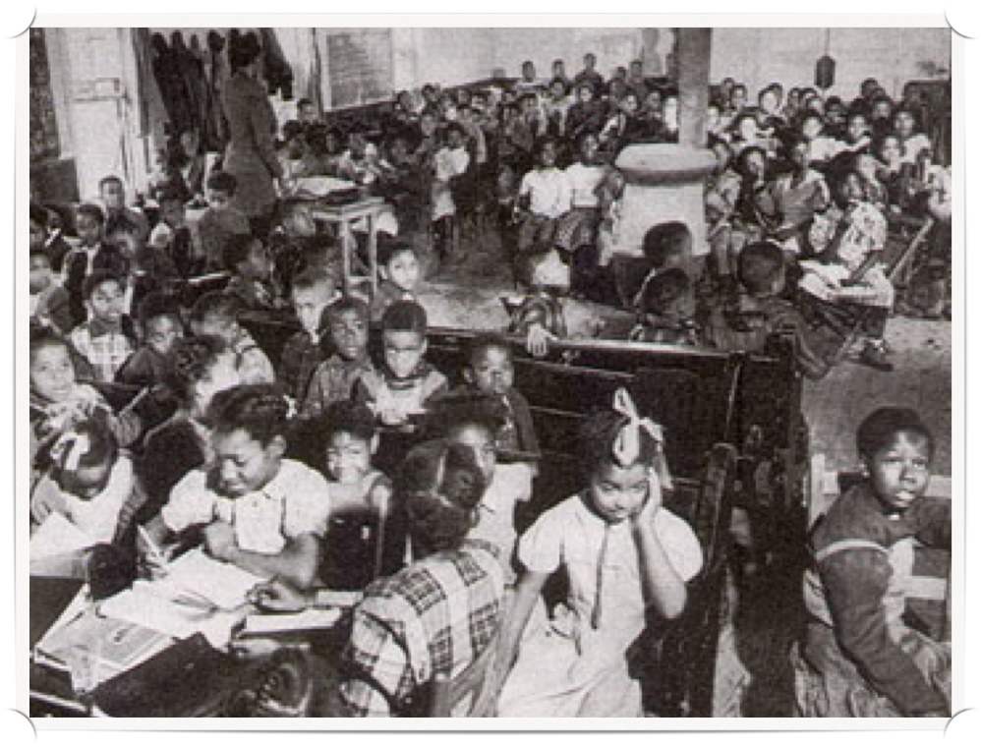
Segregated School. West Memphis, Arkansas 1949. Photograph. Black Past. Accessed 2 N

